Slide 1






S25' Training Sessions
Mobile App
SESSION 1
#create_share_innovate

Slide 2






Table of content
Introduction to Dart
Variables
Data Types
S25' Training Sessions
Comments
Operations

Slide 3



Mobile App Components
Mobile apps are built with two key components:
S25' Training Sessions
UI (User Interface): Focuses on design and use interaction.
Logic : Handles data processing and app functionality.

Slide 4
What is Dart
Dart is a programming language developed by Google, primarily used for building mobile, desktop, server, and web applications. It's the language behind Flutter, a popular framework for building cross-platform mobile apps
S25' Training Sessions

Slide 5
Why Dart
1.Cross-Platform Development
2.Fast Development with Hot Reload
3.High Performance
4.Strong Typing with Flexibility
5.Rich Standard Library and Package Ecosystem
S25' Training Sessions

Slide 6
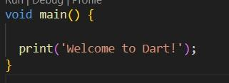
print
The Starting Point How Dart Programs Begin
S25' Training Sessions

Slide 7
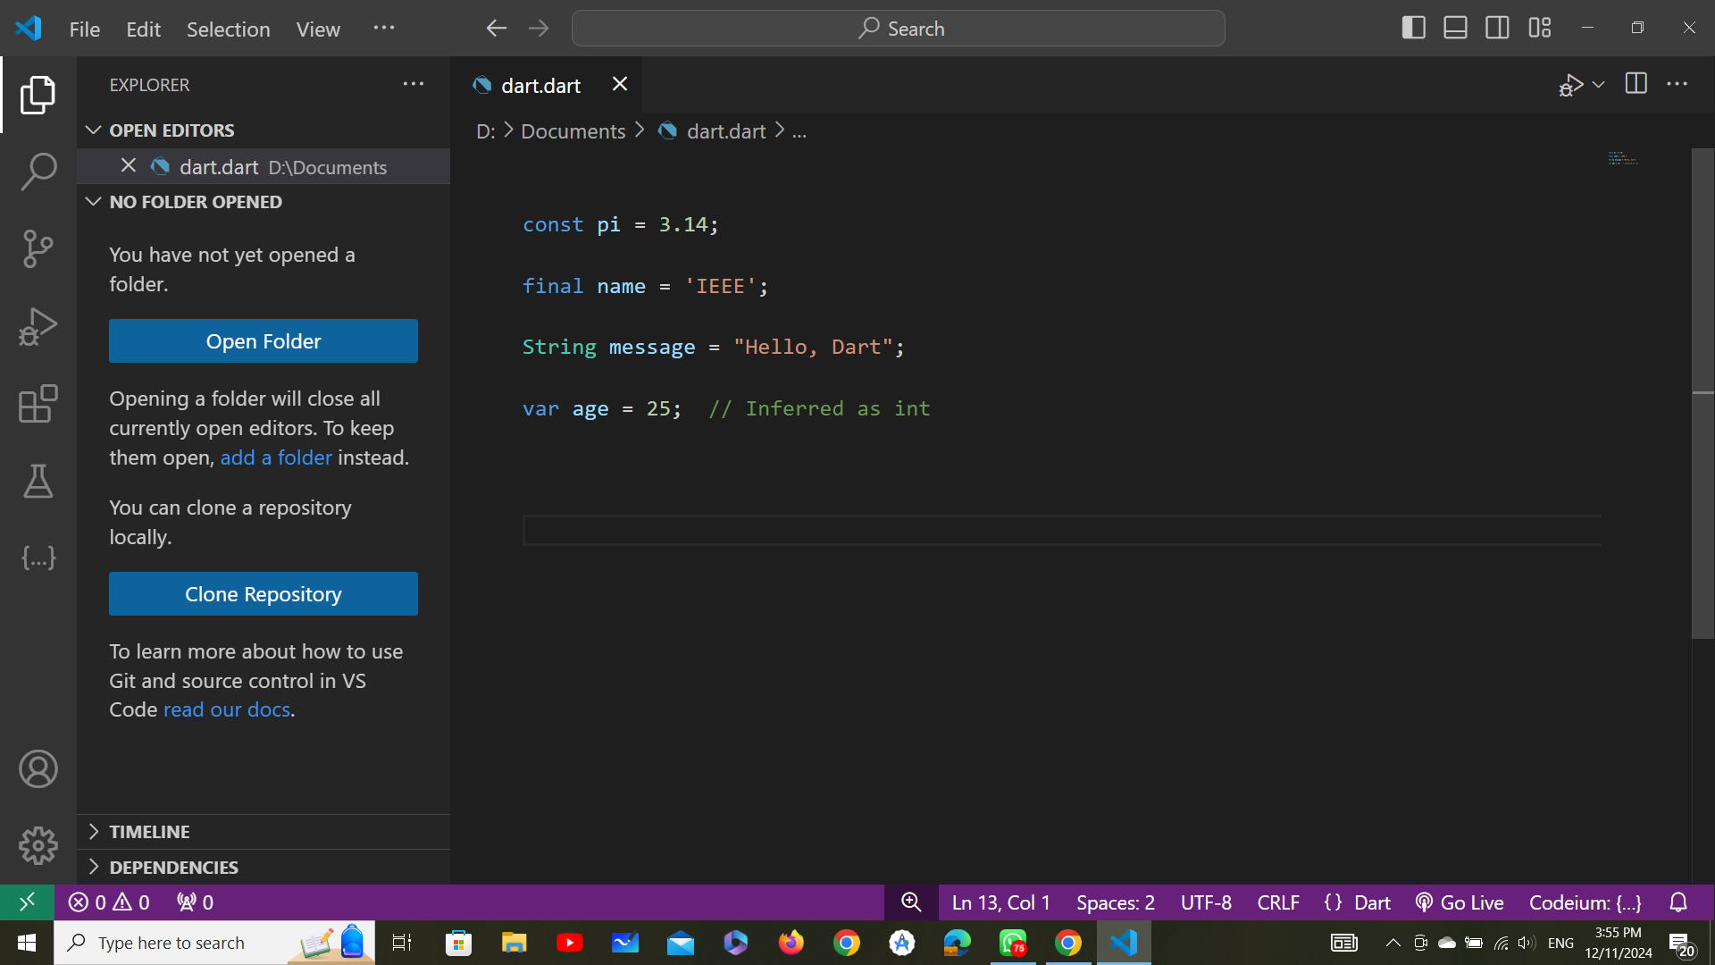
Types of Variables
1.var: Type is inferred based on the assigned value.
S25' Training Sessions
2.Explicit Types: Specify the type explicitly( int , double, string, boolean ,char).

Slide 8
Types of Variables
3.final: Immutable after assignment, value assigned at runtime.
S25' Training Sessions
4.const: Compile-time constant, value fixed during compilation.

Slide 9
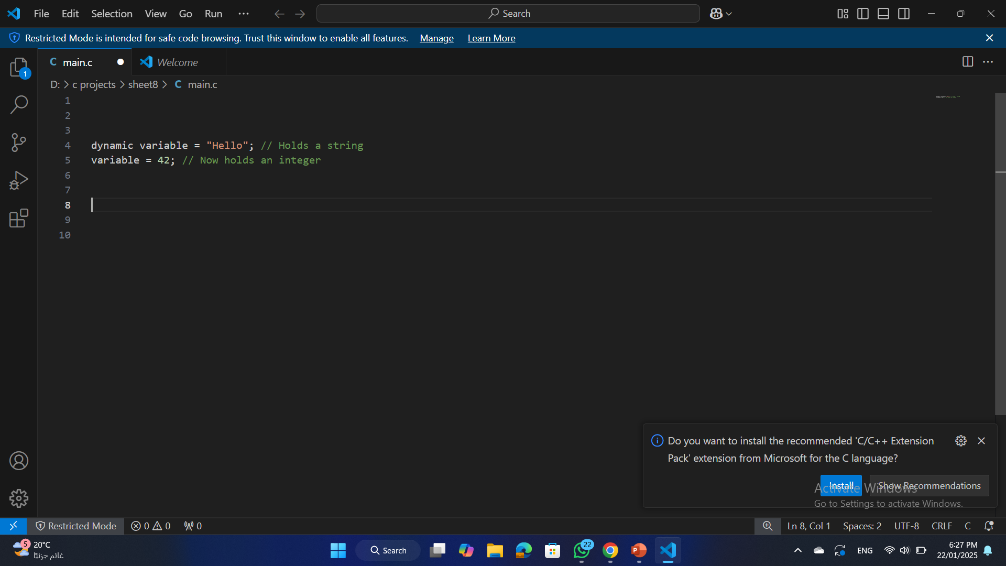
Types of Variables
5.Dynamic: can hold any type of value.
S25' Training Sessions

Slide 10
Final & const
Clear explaining the difference between FINAL and CONST:
Final Keyword
S25' Training Sessions
Meaning: The value of a final variable is set only once and cannot be
reassigned after it's initialized. However, it is evaluated at runtime.
When to use: Use final when the value is known only at runtime.

Slide 11
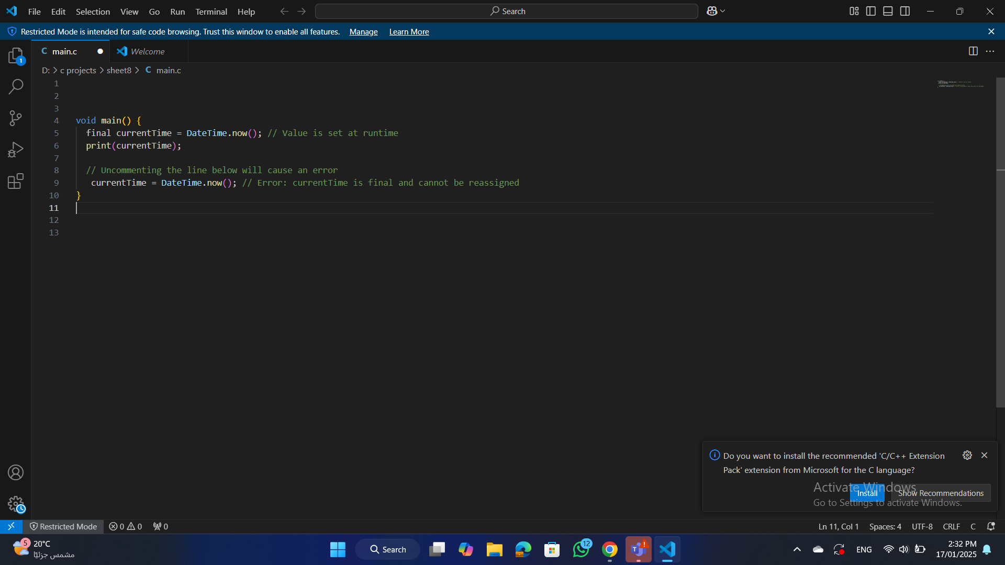
final
S25' Training Sessions
The value of currentTime is determined when the program runs,
not at compile time.

Slide 12
const
Const Keyword
S25' Training Sessions
Meaning: The value of a const variable is a compile-time constant. It must be known and fixed at compile time.
When to use: Use const for values that are immutable and known before runtime.
Shared Instances: When multiple const objects have the same value, they share the same memory instance (canonicalized).

Slide 13
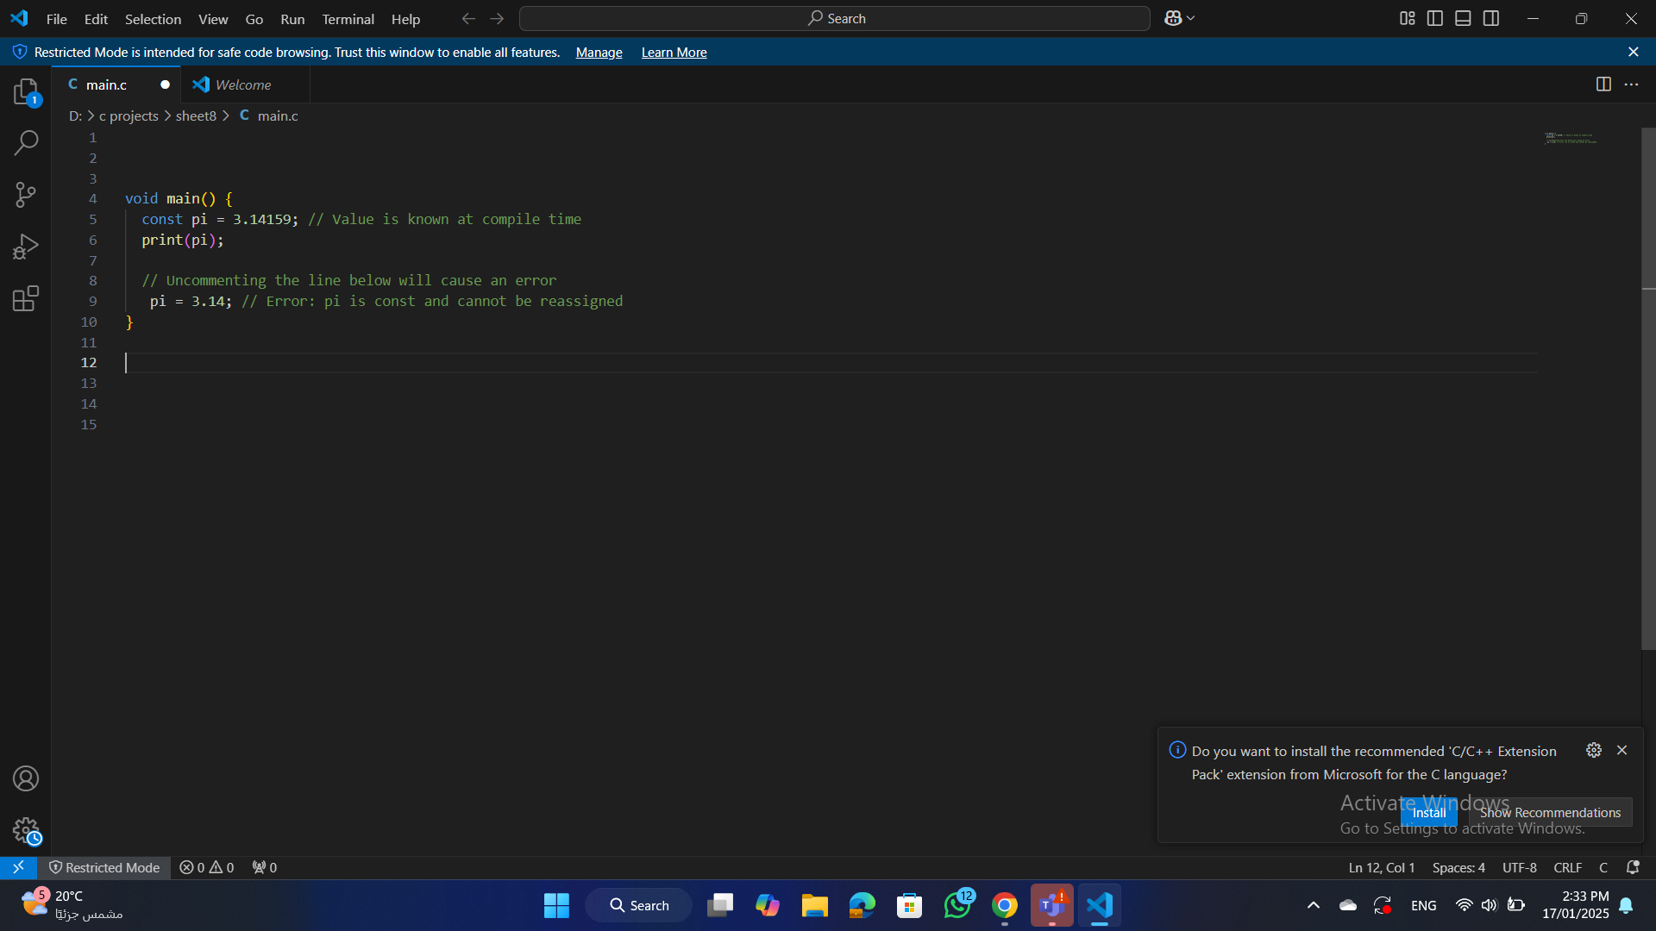
const
S25' Training Sessions

Slide 14
final & const
Feature | final | const
When Assigned | Value is set only once at runtime. | Value is set at compile time.
Mutability | Cannot be reassigned after initialization. | Cannot be reassigned after initialization.
Evaluation Time | Runtime. | Compile-time.
Examples of Use | Dynamic values like DateTime.now(). | Fixed values like math.pi.
Shared Instances | Each instance is unique. | Instances with the same value are shared.
S25' Training Sessions

Slide 15
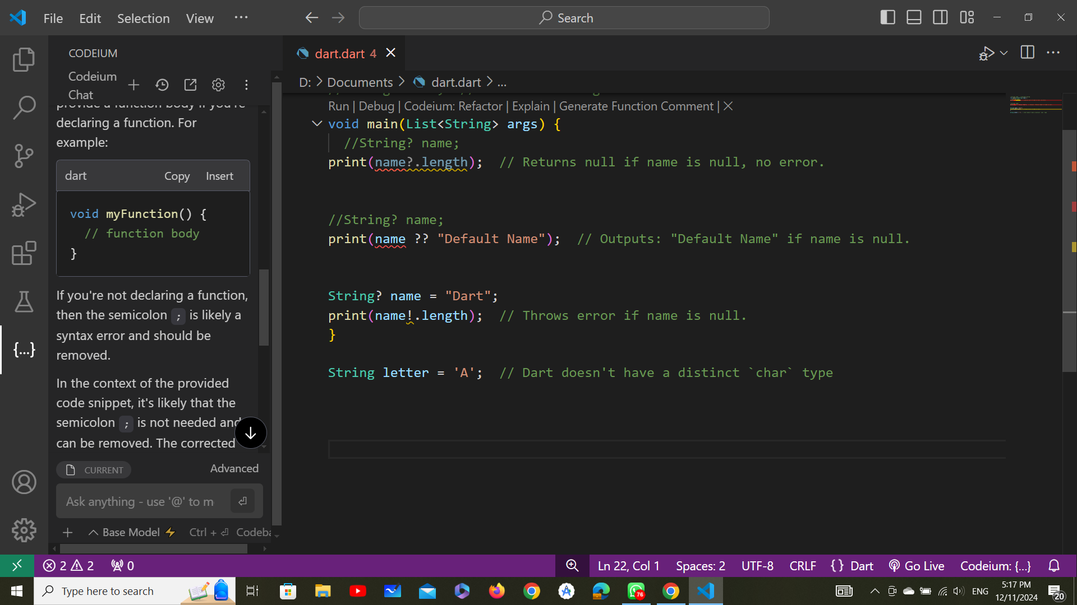
Data Types
Primitive Data Types:
int
double
string
bool
char (Dart doesn't have a char type, but it uses String for single characters):
S25' Training Sessions

Slide 16
Null Safety
What is Null Safety?
Ensures variables are non-nullable by default, preventing null reference errors.
S25' Training Sessions
Nullable vs Non-Nullable:
Non-Nullable: Cannot be null. Example: int age = 25;
Nullable: Can be null. Use ?. Example: int? age = null;

Slide 17
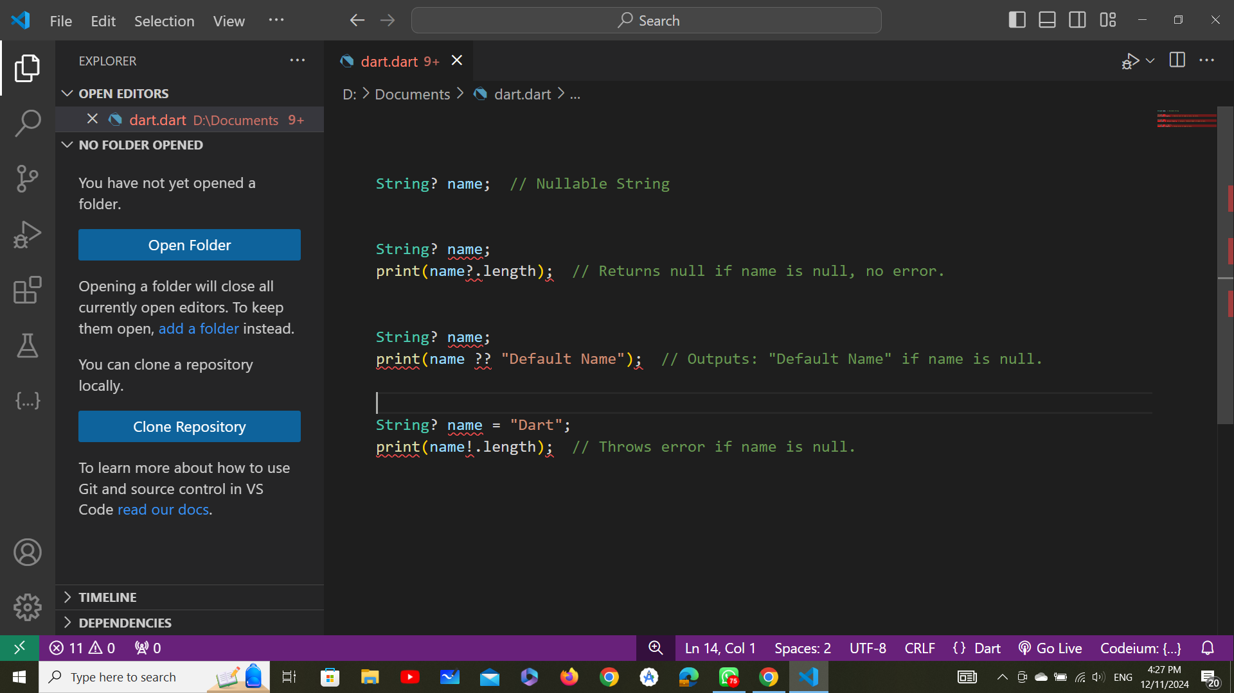
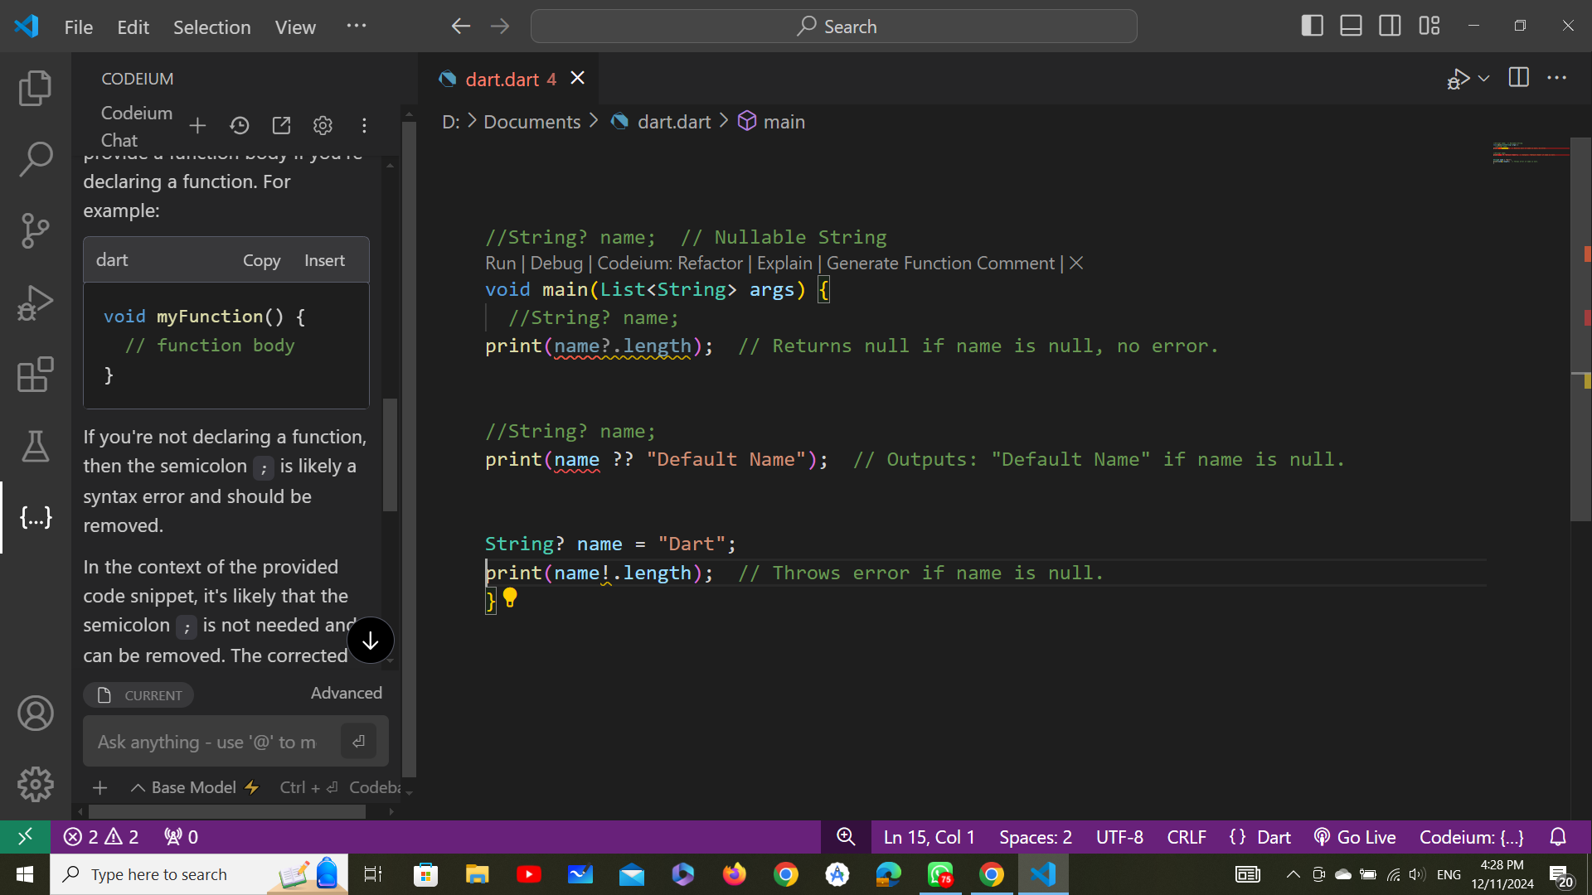
Null Safety
1.Nullable Type Declaration ( ? ): Used to declare variables that can hold null values.
S25' Training Sessions
2.Null Assertion Operator ( ! ): Forces a nullable variable to be
treated as non-null (use cautiously).

Slide 18
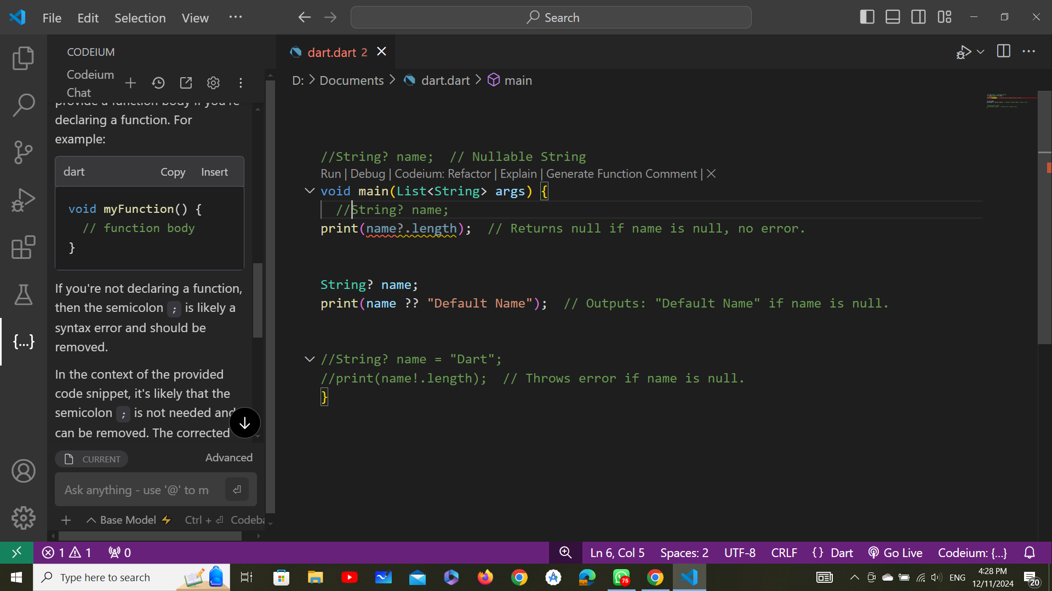
Null Safety
3.Null-Coalescing Operator ( ?? ): Provides a default value if the expression is null.
S25' Training Sessions

Slide 19
Operations
1.Arithmetic operations:
These operations are used to perform mathematical calculations.
S25' Training Sessions
+ (Addition)
- (Subtraction)
* (multiplication)
/ (division “returns a double”)
~/ (division “returns a int”)
% (Modulus “remainder of division”)

Slide 20
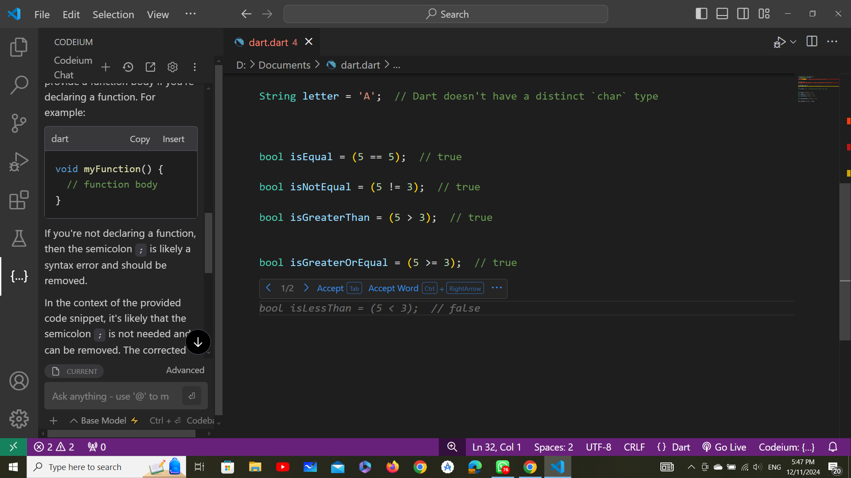
operations
2.Relational (Comparison) Operations
These operations are used to compare values, resulting in a boolean value (true or false).
S25' Training Sessions
(==) Equal to
(!=) Not Equal
<,>,>= , <=

Slide 21
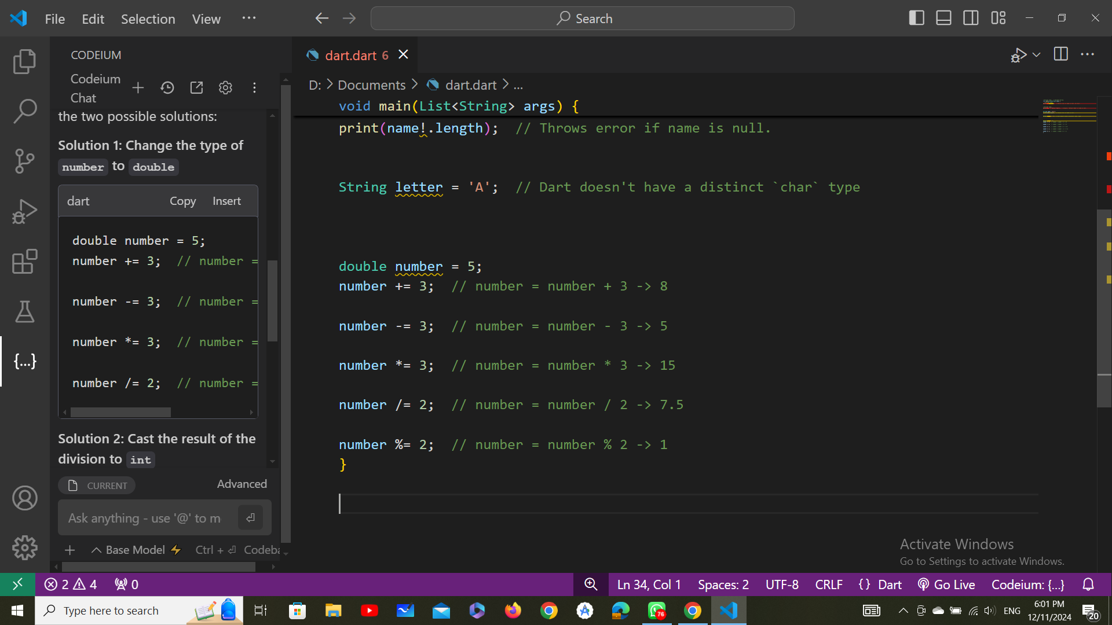
Operations
3.Assignment Operators:
S25' Training Sessions
These operations are used to
assign values to variables
(assign the right side to the left side)

Slide 22
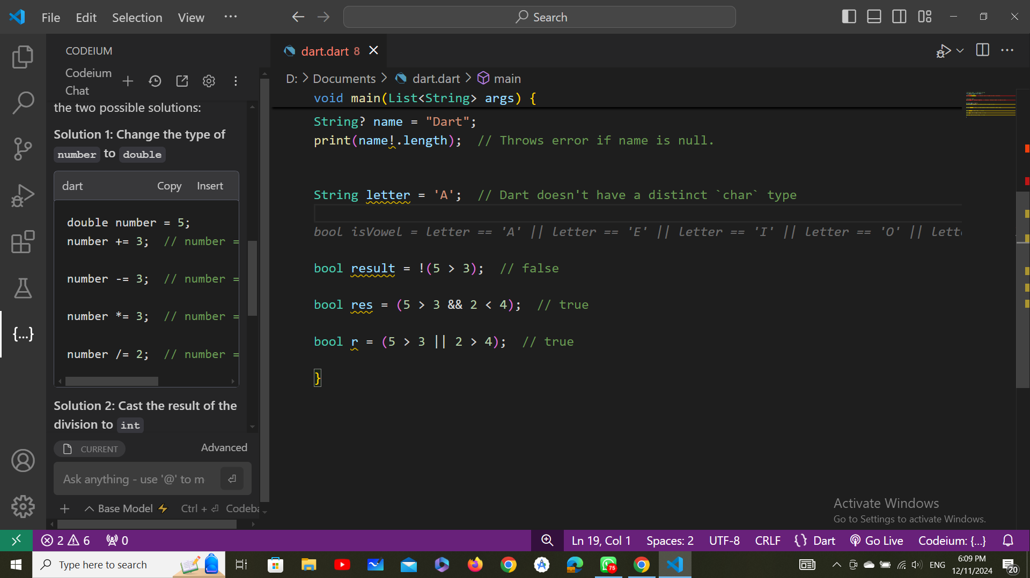
Operations
4.Logical Operators :
S25' Training Sessions
These operations are used to combine boolean expressions.
&& : Logical AND (both conditions must be true)

Slide 23
Operations
|| : Logical OR (at least one condition must be true)
S25' Training Sessions
! : Logical NOT (inverts the truth value)

Slide 24
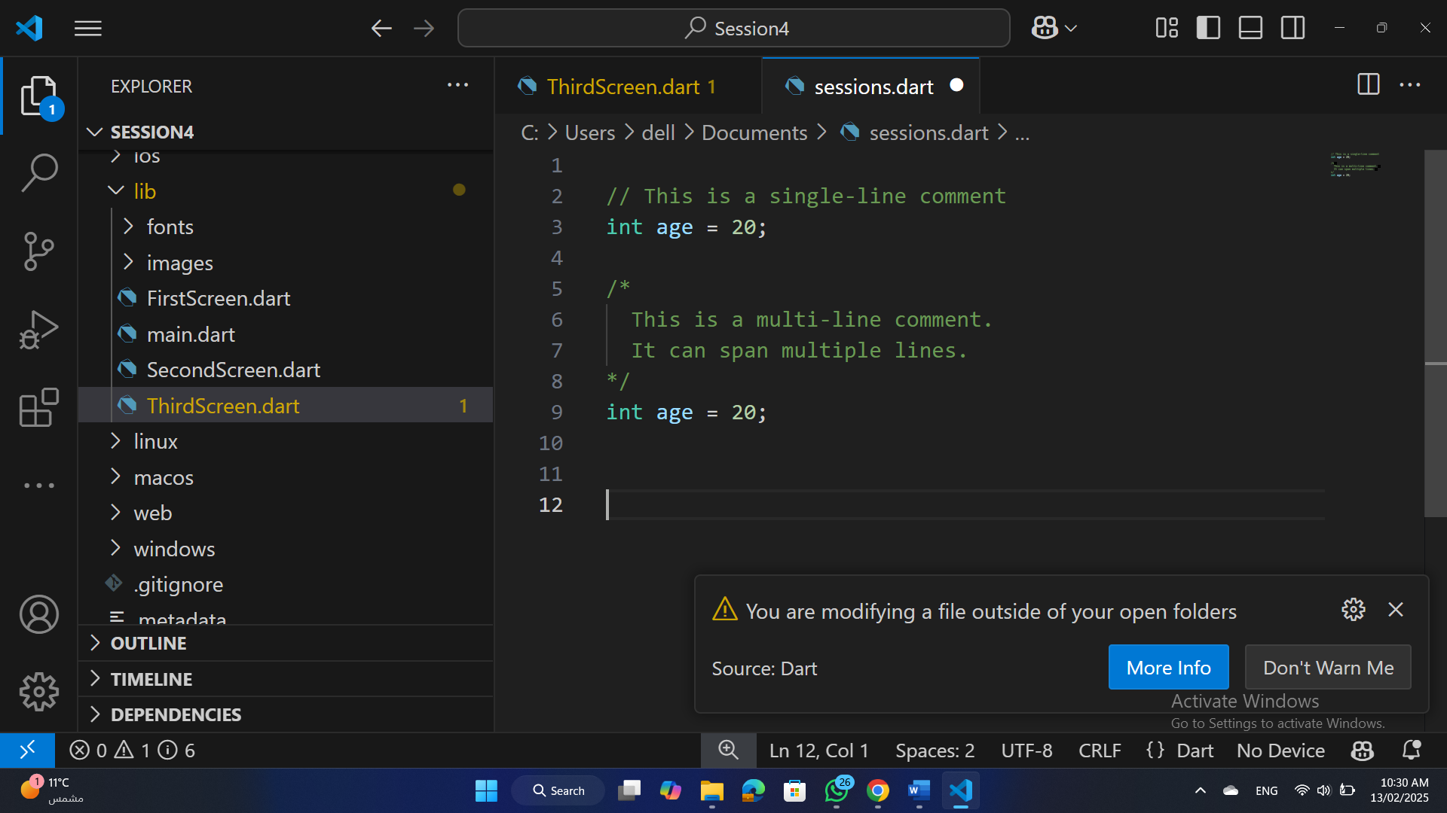
comments
Single-line Comment: Starts with // and extends to the end of the line.
Multi-line Comment: Starts with /* and ends with */.
S25' Training Sessions

Slide 25
Exercise
Write a Dart program that does the following in one statement:
Declares a variable for a user's name, birth year, and the current year.
Calculates the user's age.
Checks if the user is an adult (18 or older).
Prints a greeting message, the user's age, and whether they are an adult.
S25' Training Sessions

Slide 26
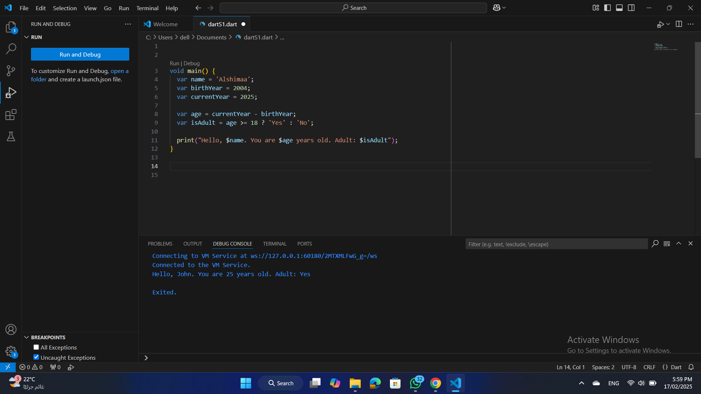
Exercise
The Solution
S25' Training Sessions

Slide 27
Task
S25' Training Sessions
Presentation teams

Slide 28

tHANK YOU
SEE YOU NEXT TIME
S25' Training Sessions

